Slide 1

Fake and real news dataset Kaggle
Link of the project:
https://github.com/lmolinario/ML-Project-Fake-Real-News/tree/main

Slide 2
Introduction
Objective:
Distinguishing fake news from real news
Dataset:
fake-and-real-news-dataset (kaggle.com)
Tools:
Python, Pandas, scikit-learn, nltk …
Util modules:
nlp, classifiers, import_dataset, text_representation ...

Slide 3
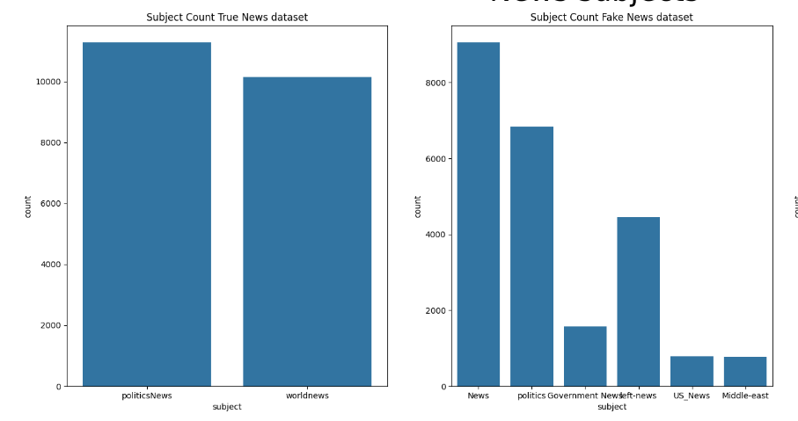
Dataset description
Two files:
Fake.csv (23502 fake news article)
True.csv (21417 true news article)
Features:
Title: title of news article
Text: body text of news article
Subject: subject of news article
Date: publish date of news article

Slide 4

Dataset manipulation
True.csv and Fake.csv loaded as Pandas Dataframe
Add new 'label' field
0 = true news
1 = fake news
Creation of a unique News Dataframe from the true and fake news
Removed unused date column

Slide 5
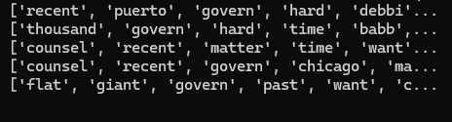
Pre processing
Extract the most meaningful information.
Append 'title' and 'text' into a new field 'title_text'
Convert 'title_text' to lowercase
Replace the non-alphanumeric characters with spaces
Remove words shorter than 3 characters
Lemmatization and stemming
Isolation of all unique words (‘filtered_unique’) from ‘filtered string’

Slide 6
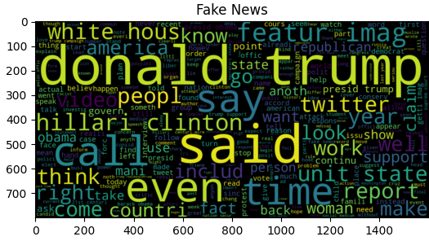
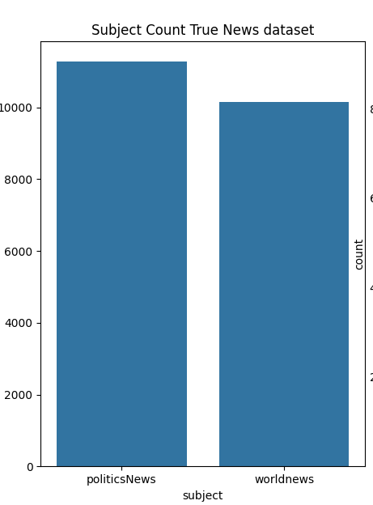
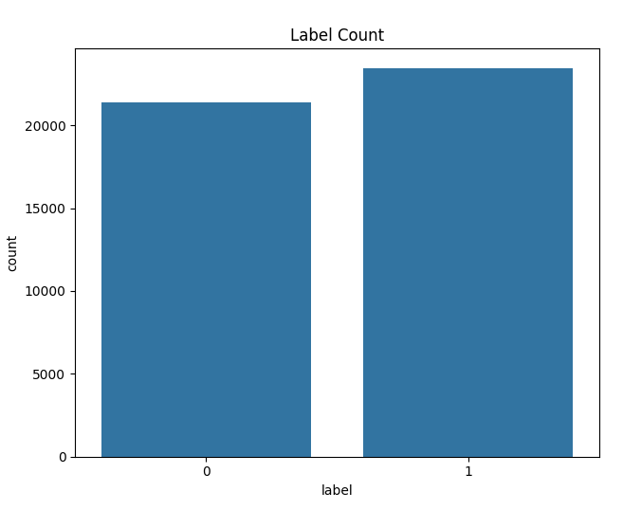
Statistical analysis
Identification of :
Total number of unique words: 41
Document with max words: id 43720 (46132 words):
Document with min words: id 33199 (28 words)
Document with max unique words: id 43923 (18196 words)
Document with min unique words: id 33199 (28 words)
Word cloud of the most common words,
Count plots of subjects in each class,
Count plot of the proportion of fake and true news in the mixed dataset.

Slide 7
Strategy Design Pattern: modular text classification pipeline
Key Features:
Abstract Class: Defines a common interface for data representation strategies.
K-Fold Cross-Validation: Splits the data into training and testing sets.
Data Representation Methods:
TokenizerRepresentation:
TextVectorizationRepresentation:
Method: TensorFlow's TextVectorization
Process: Converts text to integers, pads sequences to a fixed length
Usage: provides additional preprocessing capabilities
TFIDFRepresentation:
Method: Scikit-learn's TfidfVectorizer
Process: Converts text into TF-IDF numeric features
Usage: Emphatizing the importance of words within the corpus
Classification Strategies:
RandomForest: multiple decision trees
NaiveBayes: binary classification
MultiLayerPerceptronNet: Neural network-based using multi-layer perceptron for classification
Method: Keras Tokenizer
Process: Converts text to integers and pads sequences to a fixed length
Usage: suitable for embedding layers in neural networks

Slide 8
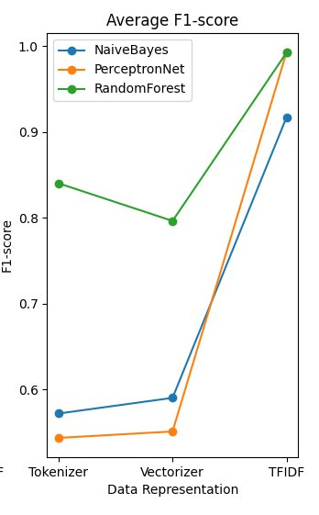
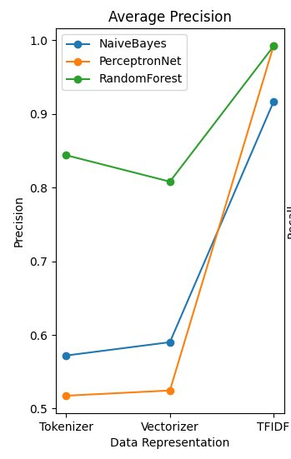
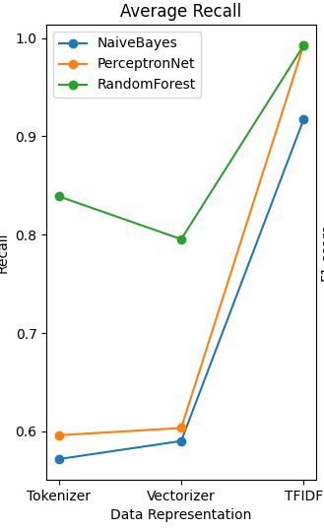
Performance Evaluation
Average Accuracy
Precision is the ratio of actual positive predictions to the total predicted positives.
Average recall
Recall is the ratio of true positive predictions to total actual positives.
Average F1 Score
The F1 score is the harmonic mean of precision and recall.

Slide 9

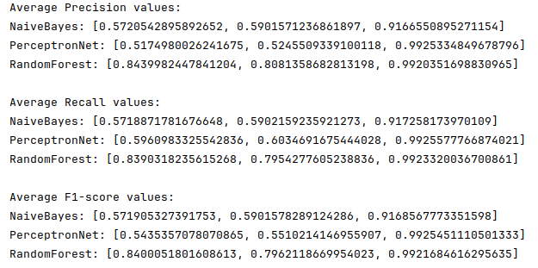
Evaluation Analysis
NaiveBayes
Best Performance Metric: TF-IDF
Why: Metrics are consistently high for TF-IDF, indicating that NaiveBayes works exceptionally well with this data representation. It shows significant improvements in precision, recall, and F1-score, highlighting its ability to leverage the importance-weighted word representation effectively.
PerceptronNet
Best Performance Metric: TF-IDF
Why: PerceptronNet exhibits the most dramatic improvement with TF-IDF, achieving near-perfect scores in all metrics. This suggests that PerceptronNet can capture and learn from the detailed features provided by TF-IDF, making it highly effective for this task.
RandomForest
Best Performance Metric: TF-IDF
Why: RandomForest maintains high performance across all data representations, with the best metrics for TF-IDF. The high F1-score indicates a good balance between precision and recall, suggesting that it effectively handles both false positives and false negatives. Its robust performance across different representations makes it a versatile choice.
Notes:
NaiveBayes Best Performance Metric: TF-IDF
Why: Metrics are consistently high for TF-IDF, indicating that NaiveBayes works exceptionally well with this data representation. It shows significant improvements in precision, recall, and F1-score, highlighting its ability to leverage the importance-weighted word representation effectively.
PerceptronNet
Best Performance Metric: TF-IDF
Why: PerceptronNet exhibits the most dramatic improvement with TF-IDF, achieving near-perfect scores in all metrics. This suggests that PerceptronNet can capture and learn from the detailed features provided by TF-IDF, making it highly effective for this task.
RandomForest
Best Performance Metric: TF-IDF
Why: RandomForest maintains high performance across all data representations, with the best metrics for TF-IDF. The high F1-score indicates a good balance between precision and recall, suggesting that it effectively handles both false positives and false negatives. Its robust performance across different representations makes it a versatile choice.
The output you have is a Classification Report and a Confusion Matrix generated by the `sklearn.metrics.classification_report` and `sklearn.metrics.confusion_matrix` functions, respectively. Let's break down the warning messages and the components of the report and matrix.
### Warning Messages
The warning messages:
```
UndefinedMetricWarning: Precision is ill-defined and being set to 0.0 in labels with no predicted samples.
Use `zero_division` parameter to control this behavior.
```
indicate that the precision metric for some labels (specifically label `0` in your case) is undefined because there are no predicted samples for that label. This means that your classifier did not predict any instances of the class `0`.
### Classification Report
The classification report provides detailed metrics on the performance of a classification model. The key metrics included are:
- **Precision**: The ratio of correctly predicted positive observations to the total predicted positives. It answers the question: "Of all the instances classified as positive, how many were actually positive?"
- **Recall**: The ratio of correctly predicted positive observations to the all observations in the actual class. It answers the question: "Of all the instances that are actually positive, how many were correctly classified?"
- **F1-Score**: The weighted average of Precision and Recall. It is a better measure than accuracy in cases where you have an uneven class distribution.
- **Support**: The number of actual occurrences of the class in the dataset.
Let's break down your report:
```
precision recall f1-score support
0 0.00 0.00 0.00 7178
1 0.52 1.00 0.68 7788
accuracy 0.52 14966
macro avg 0.26 0.50 0.34 14966
weighted avg 0.27 0.52 0.36 14966
```
- **Class 0**:
- Precision: 0.00 (No instances of class 0 were predicted as class 0)
- Recall: 0.00 (No instances of class 0 were correctly predicted)
- F1-Score: 0.00 (Harmonic mean of precision and recall)
- Support: 7178 (Total number of actual instances of class 0)
- **Class 1**:
- Precision: 0.52 (52% of instances predicted as class 1 are actually class 1)
- Recall: 1.00 (All instances of class 1 were correctly predicted)
- F1-Score: 0.68 (Harmonic mean of precision and recall)
- Support: 7788 (Total number of actual instances of class 1)
- **Accuracy**: 0.52 (Overall, 52% of the instances were correctly classified)
- **Macro Avg**:
- Precision: 0.26 (Average precision across classes)
- Recall: 0.50 (Average recall across classes)
- F1-Score: 0.34 (Average F1-score across classes)
- **Weighted Avg**:
- Precision: 0.27 (Average precision weighted by the number of true instances for each class)
- Recall: 0.52 (Average recall weighted by the number of true instances for each class)
- F1-Score: 0.36 (Average F1-score weighted by the number of true instances for each class)
### Confusion Matrix
The confusion matrix shows the counts of actual vs. predicted classifications:
```
[[ 0 7178]
[ 0 7788]]
```
- **Row 0 (Actual Class 0)**:
- 0 instances of class 0 were correctly predicted as class 0 (True Negative)
- 7178 instances of class 0 were incorrectly predicted as class 1 (False Positive)
- **Row 1 (Actual Class 1)**:
- 0 instances of class 1 were incorrectly predicted as class 0 (False Negative)
- 7788 instances of class 1 were correctly predicted as class 1 (True Positive)
### Interpretation
Your model is heavily biased towards predicting class 1. It failed to predict any instances of class 0, resulting in undefined precision for class 0. This could be due to various reasons such as imbalanced classes, poor model training, or inappropriate model choice.
### Recommendations
1. **Address Class Imbalance**: If your dataset is imbalanced, consider techniques like oversampling the minority class, undersampling the majority class, or using synthetic data generation methods (e.g., SMOTE).
2. **Model Tuning**: Adjust model parameters, use different algorithms, or employ ensemble methods to improve performance.
3. **Evaluation Metrics**: Use additional evaluation metrics such as ROC-AUC, which can provide more insight into model performance, especially for imbalanced datasets.
4. **Zero Division Parameter**: Use the `zero_division` parameter in `classification_report` to control the behavior when a metric is undefined (e.g., `zero_division=1` to set undefined metrics to 1).
Notes for Presenter:
NaiveBayes:
"For the NaiveBayes model, we observed that the best performance metric was achieved with the TF-IDF representation. The reason is that TF-IDF allows the model to weigh the importance of words within the document context, which improves precision, recall, and F1-score significantly. This indicates that NaiveBayes can effectively leverage the weighted word representation provided by TF-IDF."
PerceptronNet:
"Similarly, the PerceptronNet model showed its best performance with TF-IDF, achieving near-perfect scores in all metrics. This suggests that PerceptronNet can effectively capture and learn from the detailed features provided by TF-IDF, making it highly effective for this classification task."
RandomForest:
"The RandomForest model maintained high performance across all data representations, with the best metrics for TF-IDF. The high F1-score suggests a good balance between precision and recall, indicating it effectively handles both false positives and false negatives. This robustness across different data representations makes RandomForest a versatile and reliable choice."

Slide 10

Conclusion
Model with the Best Performance Overall
Random Forest consistently has high metrics across all representations, indicating robust performance regardless of the data representation used.
Why Random Forest Works Better?
Ensemble Learning: Uses multiple decision trees, reducing overfitting and improving generalization.
Robustness: Handles variance and bias balancing well by averaging multiple trees.
Feature Importance: Effectively handles high-dimensional data and identifies important features, improving performance across different data representations.

